Slide 1


Agnieszka Haja
1.09.2023

Slide 2

Outline
Executive Summary
Introduction
Methodology
Results
Conclusion
Appendix

Slide 3
Executive Summary
Summary of Methodologies:
I gathered data from both a public SpaceX API and scraped SpaceX's Wikipedia page. After preprocessing and labeling, I stored it in a DB2 SQL database. I utilized various machine learning algorithms, resulting in an 83% accuracy rate for predicting successful Stage 1 landings.
Summary of All Results:
The machine learning model I developed, with an 83% accuracy rate, is a valuable tool for SpaceY. It assists in evaluating the likelihood of successful launches, potentially saving up to $100 million USD per launch. While my visualization dashboard enhances decision-making, I recommend ongoing data collection to further refine and enhance model accuracy.

Slide 4
Introduction
In this capstone project, my main goal is to predict the successful landing of the Falcon 9 first stage, a critical aspect of SpaceX's cost-efficient rocket launches. SpaceX advertises Falcon 9 launches for $62 million, significantly cheaper than competitors who charge over $165 million due to SpaceX's innovative first stage reuse. Accurate landing predictions can determine launch costs and support competitive bidding. I'll collect and format data from the SpaceX API to develop this model.
In this project I want to find answers to questions:
Can I create a precise model to predict Falcon 9 first stage landings, crucial for SpaceX's cost-effective launches?
How can I use this model to estimate launch costs based on first stage landing outcomes?

Slide 5

Section 1

Slide 6
Methodology
Executive Summary
Data collection methodology:
Colected data from SpaceX public API and SpaceX Wikipedia page
•
Perform data wrangling
Classifying true landings as successful and unsuccessful otherwise
Perform exploratory data analysis (EDA) using visualization and SQL
Perform interactive visual analytics using Folium and Plotly Dash
Perform predictive analysis using classification models
Classifying true landings as successful and unsuccessful
•

Slide 7
Data Collection
The data acquisition process involved a combination of obtaining information through API requests from SpaceX's public API and extracting data by web scraping a table found in SpaceX's Wikipedia page.
Next I will illustrate the data collection process from the API, while the subsequent slide will depict the data collection procedure through web scraping.
Columns obtained from SpaceX's API data include: FlightNumber, Date, BoosterVersion, PayloadMass, Orbit, LaunchSite, Outcome, Flights, GridFins, Reused, Legs, LandingPad, Block, ReusedCount, Serial, Longitude, and Latitude.
In contrast, the data columns extracted through web scraping from SpaceX's Wikipedia page encompass: Flight No., Launch site, Payload, PayloadMass, Orbit, Customer, Launch outcome, Version Booster, Booster landing, Date, and Time.

Slide 8
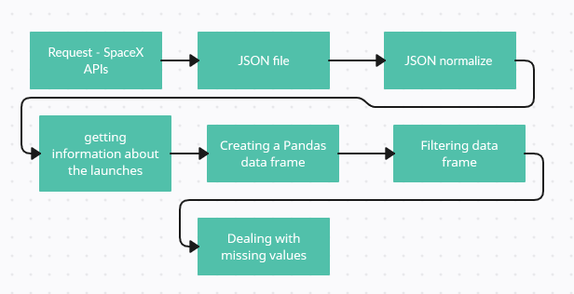
Data Collection – SpaceX API
https://github.com/miraylin/Applied-Data-Science-Capstone/blob/main/jupyter-labs-spacex-data-collection-api.ipynb

Slide 9
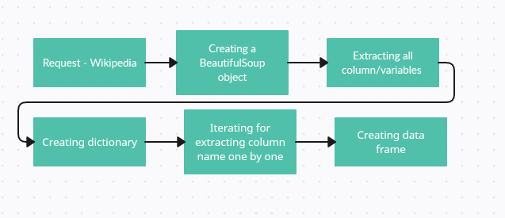
Data Collection - Scraping
https://github.com/miraylin/Applied-Data-Science-Capstone/blob/main/jupyter-labs-webscraping.ipynb

Slide 10
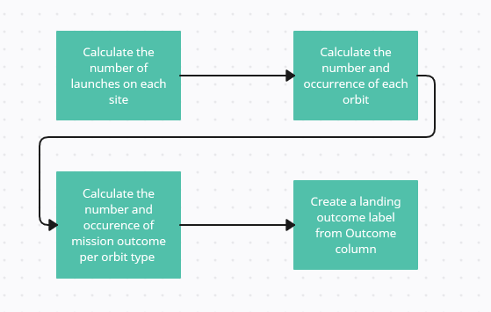
Data Wrangling
https://github.com/miraylin/Applied-Data-Science-Capstone/blob/main/IBM-DS0321EN-SkillsNetwork_labs_module_1_L3_labs-jupyter-spacex-data_wrangling_jupyterlite.jupyterlite.ipynb

Slide 11
EDA with Data Visualization
Perform exploratory Data Analysis and Feature Engineering using Pandas and Matplotlib - Exploratory Data Analysis - Preparing Data Feature Engineering
Plots: Flight Number vs. Payload Mass, Flight Number vs. Launch Site, Payload Mass vs. Launch Site, Orbit vs. Success Rate, Flight Number vs. Orbit, Payload vs Orbit, Success Yearly Trend
I employed scatterplots, line charts and bar graphs to explore connections between variables, assessing their interrelationships to determine their suitability for inclusion in the machine learning model's training dataset.
https://github.com/miraylin/Applied-Data-Science-Capstone/blob/main/IBM-DS0321EN-SkillsNetwork_labs_module_2_jupyter-labs-eda-dataviz.ipynb.jupyterlite.ipynb

Slide 12
EDA with SQL
1. Understand the Spacex DataSet
2. Load the dataset into the corresponding table in a Db2 database
3. Execute SQL queries to answer assignment questions:
- names of the unique launch sites in the space mission
- 5 records where launch sites begin with the string 'CCA'
- total payload mass carried by boosters launched by NASA (CRS)
- average payload mass carried by booster version F9 v1.1
- date when the first succesful landing outcome in ground pad was achieved
- names of the boosters which have success in drone ship and have payload mass greater than 4000 but less than 6000
- total number of successful and failure mission outcomes
- names of the booster_versions which have carried the maximum payload mass
- records which will display the month names, failure landing_outcomes in drone ship ,booster versions, launch_site for the months in year 2015
- Rank the count of landing outcomes (such as Failure (drone ship) or Success (ground pad)) between the date 2010-06-04 and 2017-03-20, in descending order
https://github.com/miraylin/Applied-Data-Science-Capstone/blob/main/jupyter-labs-eda-sql-coursera_sqllite.ipynb

Slide 13
Build an Interactive Map with Folium
Folium maps are utilized to pinpoint the precise locations of launch sites, distinguish between successful and unsuccessful landings, and illustrate proximity to significant landmarks, including railways, highways, coastlines, and urban centers. This visual approach offers insights into the rationale behind the selection of launch site locations and provides a clear visualization of the geographical distribution of successful landings.
https://github.com/miraylin/Applied-Data-Science-Capstone/blob/main/IBM-DS0321EN-SkillsNetwork_labs_module_3_lab_jupyter_launch_site_location.jupyterlite.ipynb

Slide 14
Build a Dashboard with Plotly Dash
I've created a SpaceX Launch Records Dashboard using Dash, featuring
- a dropdown menu for launch site selection, a pie chart showing success rates by site, a payload mass range slider for data filtering, and a scatter plot illustrating the relationship between payload mass and launch success.
These interactive components enhance the user experience by allowing me to explore success rates, analyze payload mass influence, and filter data according to my preferences. The dashboard is designed for a comprehensive analysis of SpaceX launch records.
https://github.com/miraylin/Applied-Data-Science-Capstone/blob/main/spacex_dash_app.py

Slide 15
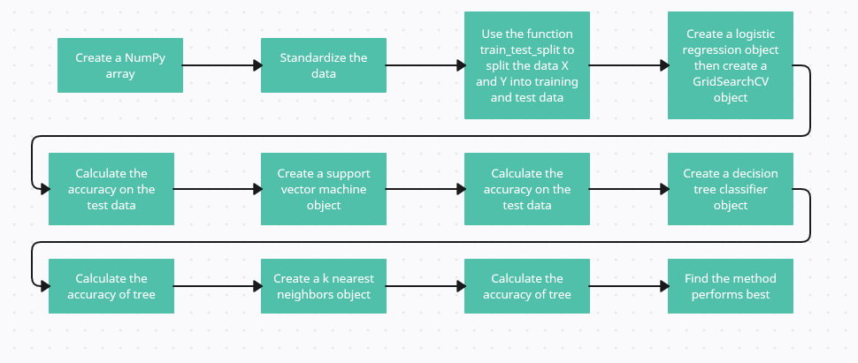
Predictive Analysis (Classification)
https://github.com/miraylin/Applied-Data-Science-Capstone/blob/main/IBM-DS0321EN-SkillsNetwork_labs_module_4_SpaceX_Machine_Learning_Prediction_Part_5.jupyterlite.ipynb

Slide 16
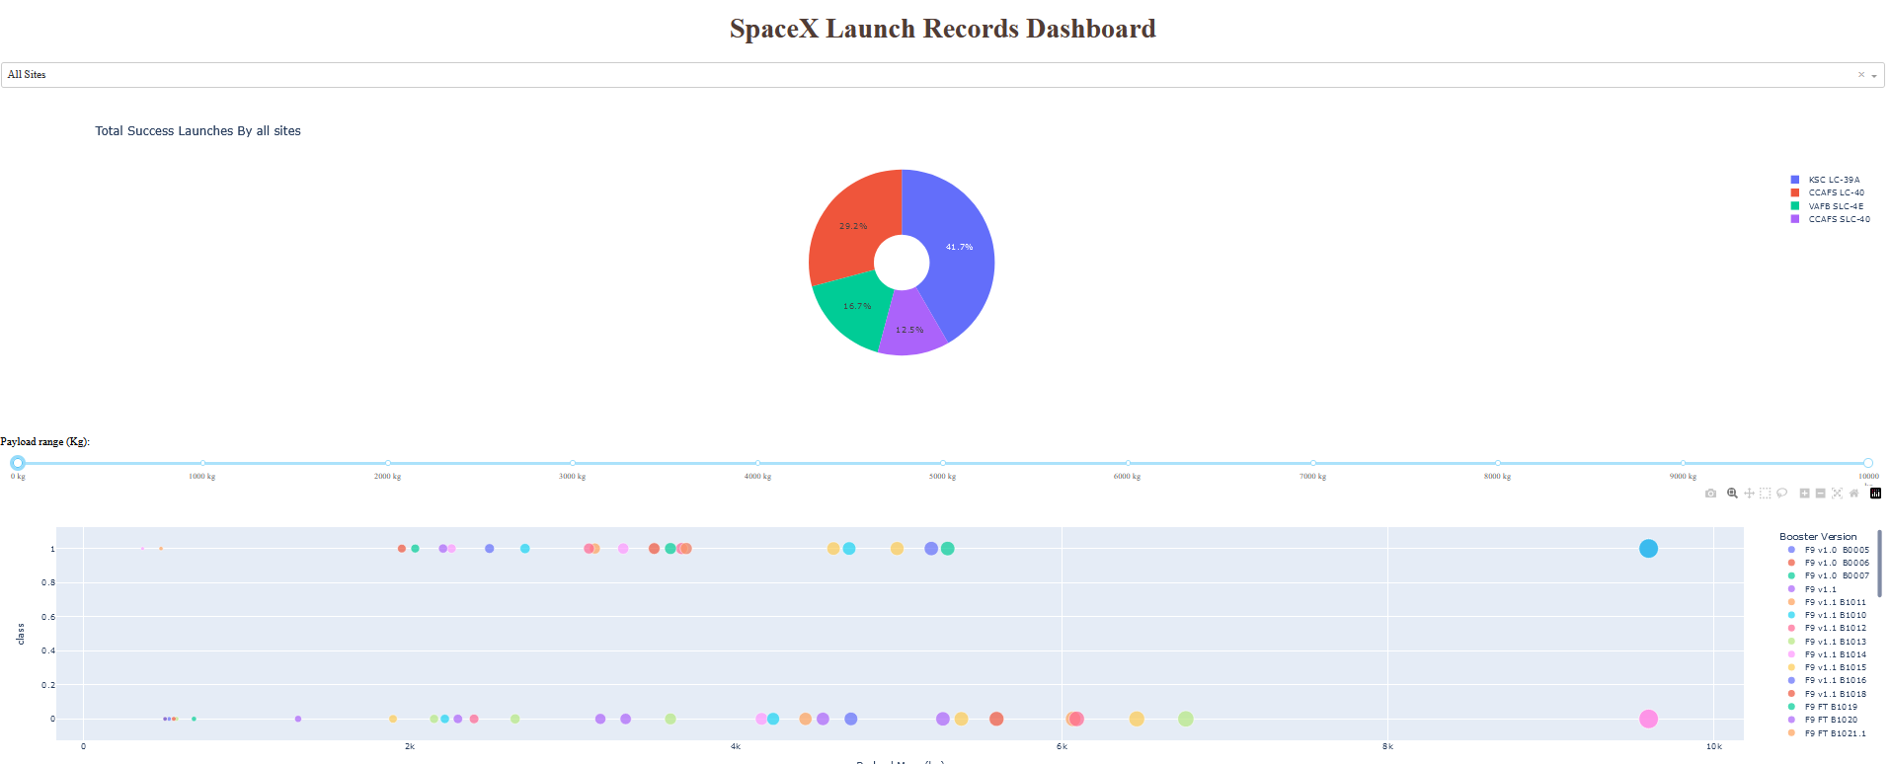
Results
The provided code used there primarily focuses on exploratory data analysis and interactive visualization.
This is a preview of a SpaceX Launch Records Dashboard:

Slide 17

Section 2

Slide 18
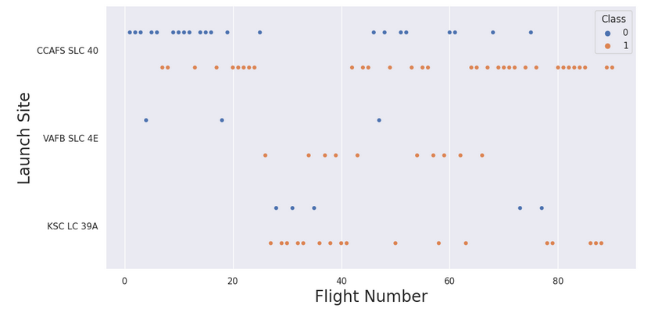
Flight Number vs. Launch Site
In simpler terms, the scatter plot indicates that when a launch site can accommodate a larger payload mass, the likelihood of a successful launch is higher.

Slide 19
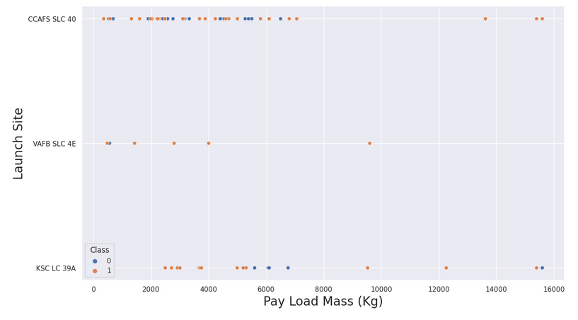
Payload vs. Launch Site
It seems that the majority of payload masses fall within the range of 0-6000 kilograms. Additionally, various launch sites appear to have different preferences when it comes to the payload mass they handle

Slide 20
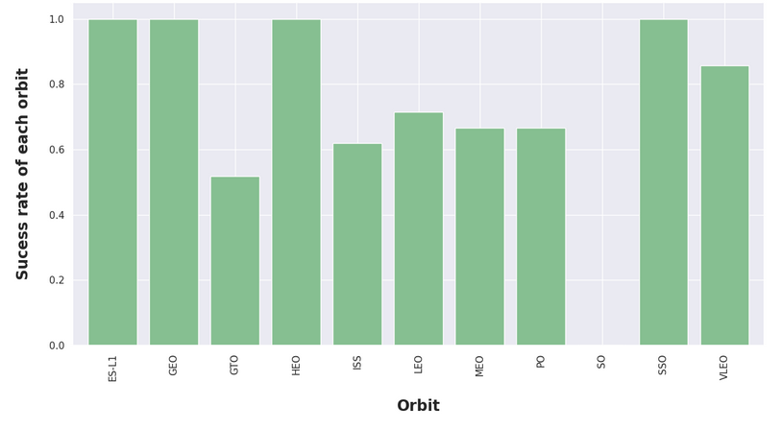
Success Rate vs. Orbit Type
ES-L1, GEO, and HEO, each with a sample size of one, have a 100% success rate. SSO, with a sample size of five, also boasts a perfect 100% success rate. VLEO, which has seen 14 attempts, has a respectable success rate, indicating a noteworthy level of success. In contrast, SO, with a sample size of one, has a 0% success rate, while GTO, with the largest sample size of 27, maintains a success rate of approximately 50%, making it the most extensively sampled category.

Slide 21
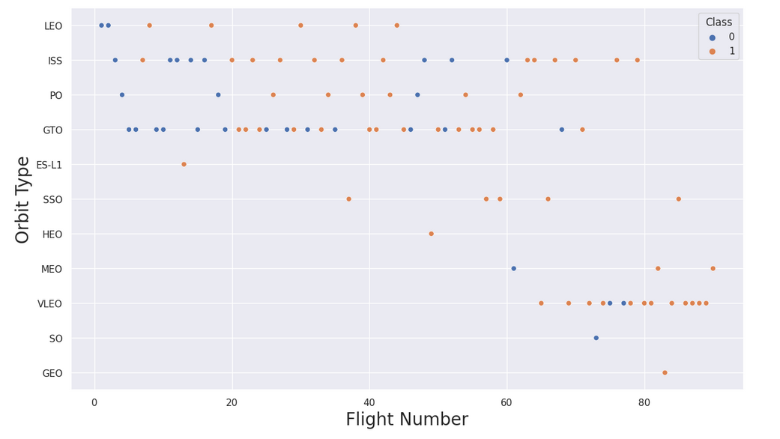
Flight Number vs. Orbit Type
Over the course of their flight numbers, SpaceX's launch orbit preferences have evolved. They began with a focus on Low Earth Orbits (LEO), which yielded moderate success rates. Subsequently, they transitioned back to Very Low Earth Orbits (VLEO) in recent launches. Notably, SpaceX's performance appears to be more favorable in lower orbits or Sun-synchronous orbits, as there seems to be a correlation between launch outcomes and orbit selection.

Slide 22
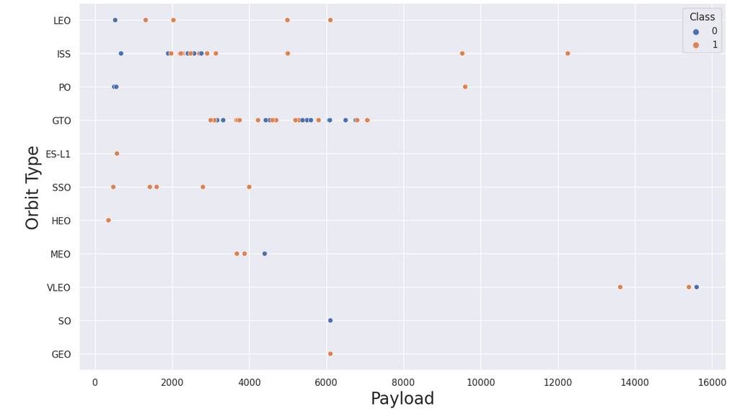
Payload vs. Orbit Type
There appears to be a correlation between payload mass and launch orbit. Orbits such as Low Earth Orbit (LEO) and Sun-synchronous orbit (SSO) tend to have relatively lower payload masses. In contrast, the most successful orbit, Very Low Earth Orbit (VLEO), primarily features payload mass values on the higher end of the spectrum. This suggests that the choice of orbit is associated with the payload mass, with VLEO being more suitable for heavier payloads, while LEO and SSO are preferred for lighter payloads

Slide 23
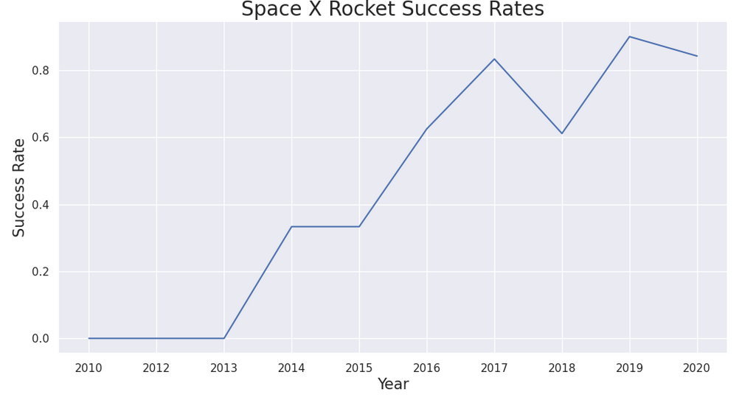
Launch Success Yearly Trend
The trend in launch success has generally been on the rise since 2013, with a minor decrease observed in 2018. In recent years, success rates have stabilized at approximately 80%, indicating a relatively consistent level of successful launches.

Slide 24
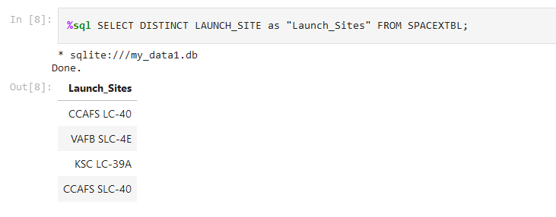
All Launch Site Names
Displaying the names of the unique launch sites in the space mission

Slide 25
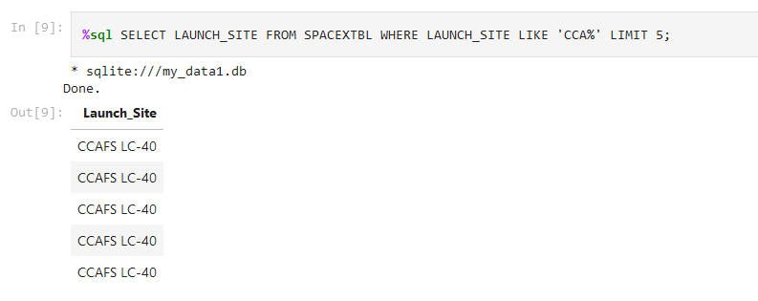
Launch Site Names Begin with 'CCA'
Displaying 5 records where launch sites begin with the string 'CCA'

Slide 26
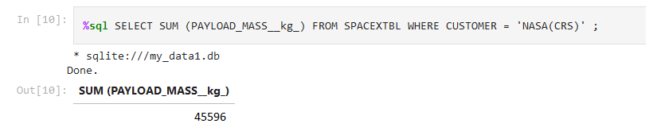
Total Payload Mass
Displaying the total payload mass carried by boosters launched by NASA (CRS)

Slide 27
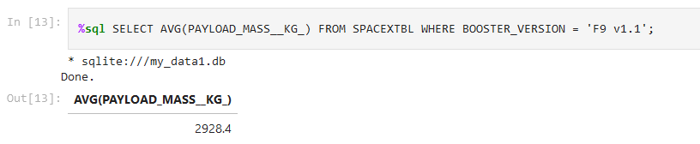
Average Payload Mass by F9 v1.1
Displaying average payload mass carried by booster version F9 v1.1

Slide 28
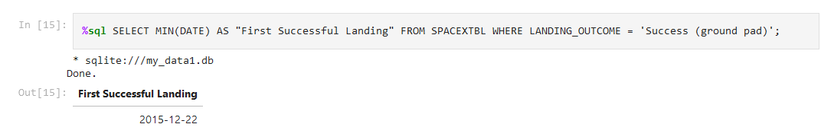
First Successful Ground Landing Date
The date when the first succesful landing outcome in ground pad was acheived.

Slide 29
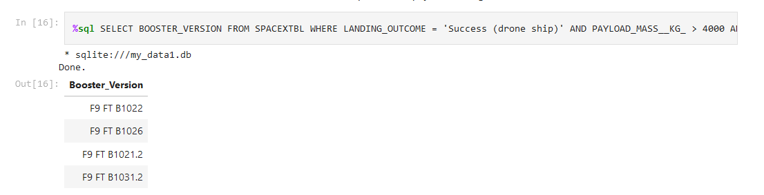
Successful Drone Ship Landing with Payload between 4000 and 6000
List of the names of the boosters which have success in drone ship and have payload mass greater than 4000 but less than 6000.

Slide 30
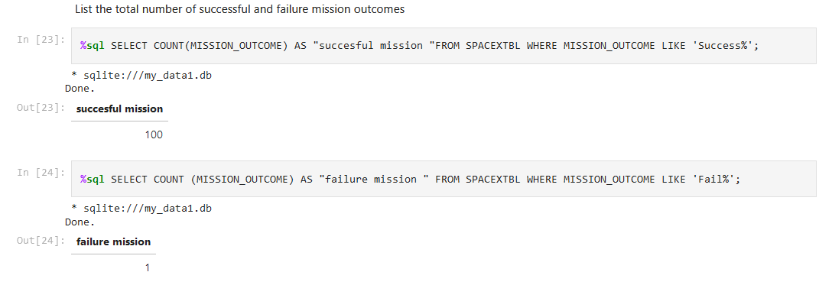
Total Number of Successful and Failure Mission Outcomes
List of the total number of successful and failure mission outcomes

Slide 31
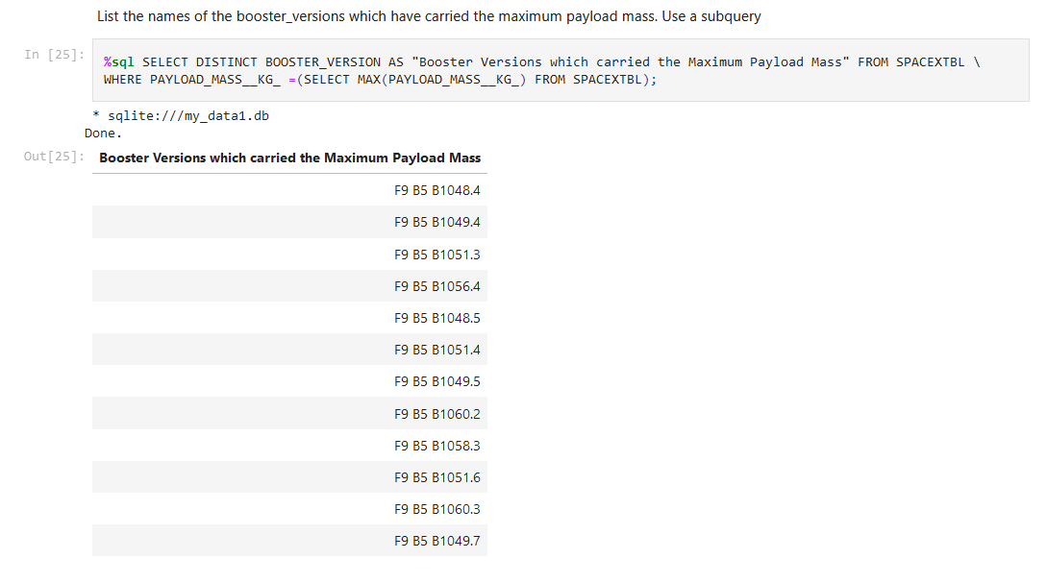
Boosters Carried Maximum Payload
List of the names of the booster_versions which have carried the maximum payload mass with using a subquery.

Slide 32
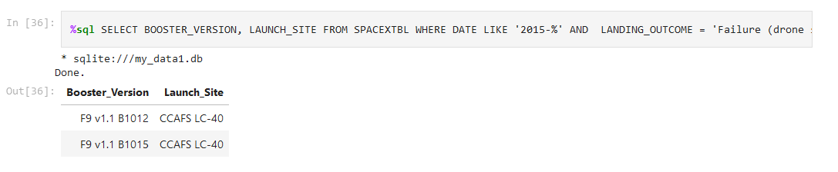
2015 Launch Records
List of the records which will display the month names, failure landing_outcomes in drone ship ,booster versions, launch_site for the months in year 2015.

Slide 33
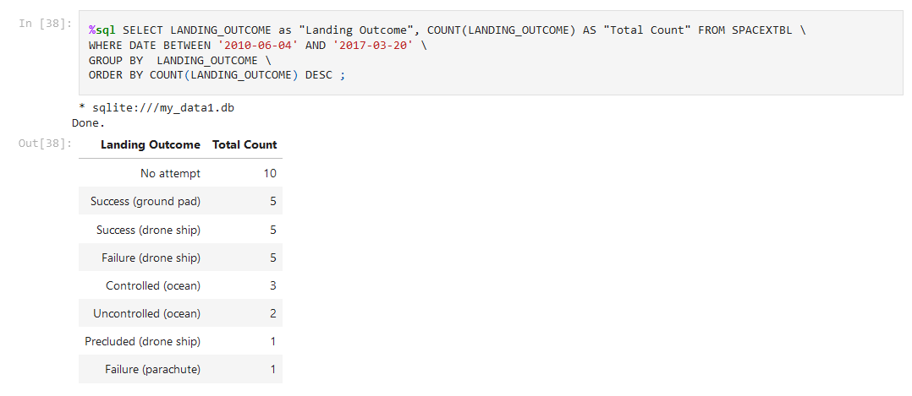
Rank Landing Outcomes Between 2010-06-04 and 2017-03-20
Rank the count of landing outcomes (such as Failure (drone ship) or Success (ground pad)) between the date 2010-06-04 and 2017-03-20, in descending order

Slide 34

Section 3

Slide 35
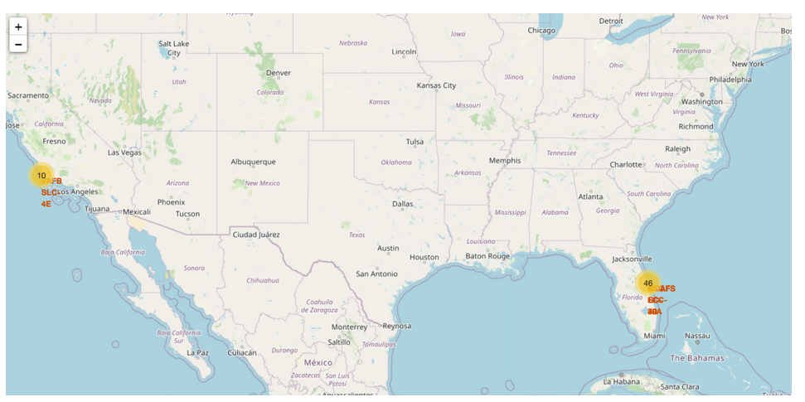
Launch Site Locations
All launch sites on a map.

Slide 36
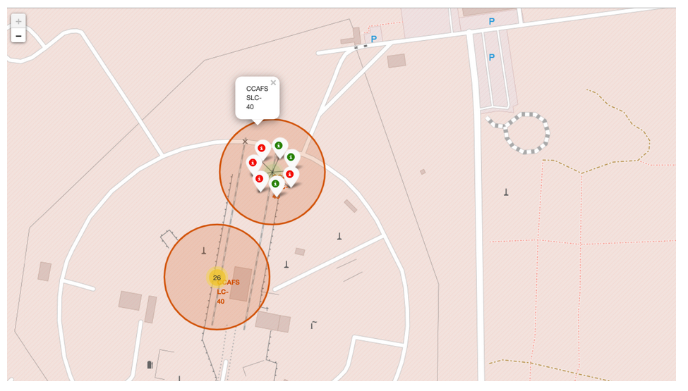
Color-Coded Launch Markers
Green represents successful landing (there are 3) and unsuccessful as a red markers (there are 4 red).

Slide 37

Section 4

Slide 38
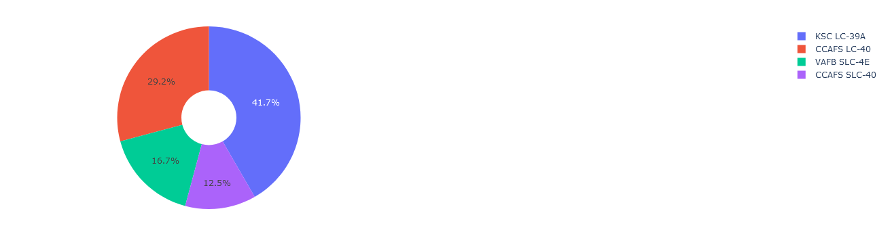
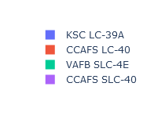
Total Success Launches by all sites
This data represents the distribution of successful rocket landings at various launch sites. It's worth noting that CCAFS LC-40 and CCAFS SLC-40 are essentially the same location, so CCAFS and KSC share an equal number of successful landings. However, a significant portion of these successes occurred before the name change from CCAFS LC-40 to CCAFS SLC-40. On the other hand, VAFB has the lowest percentage of successful landings, possibly influenced by a smaller sample size and the increased challenges associated with launching from the West Coast.

Slide 39
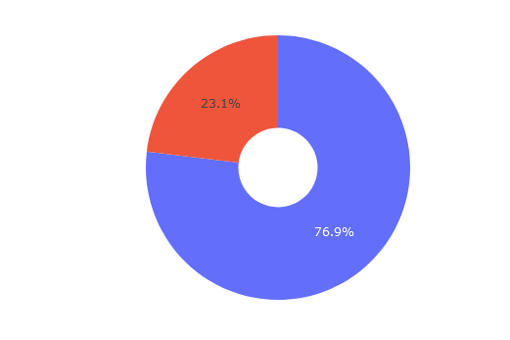
Total Success Launches for site KSC LC-39A
KSC LC-39A has the highest success rate.
Blue means Success, Red failed launches.

Slide 40
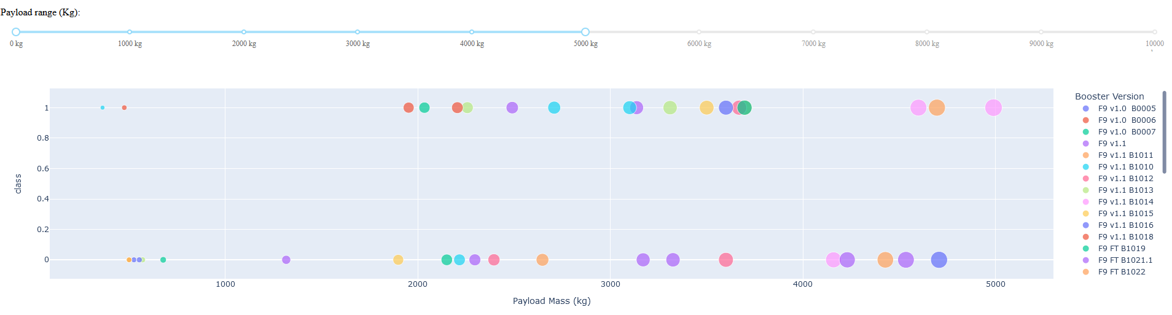
Payload Mass vs. Success vs. Booster Version
In the Plotly dashboard, the Payload range selector is currently configured with a range from 0 to 10,000. The "Class" variable is used to signify successful landings (1) and failures (0). The scatter plot additionally incorporates booster version categories for color representation and the number of launches for point size.

Slide 41

Section 5

Slide 42
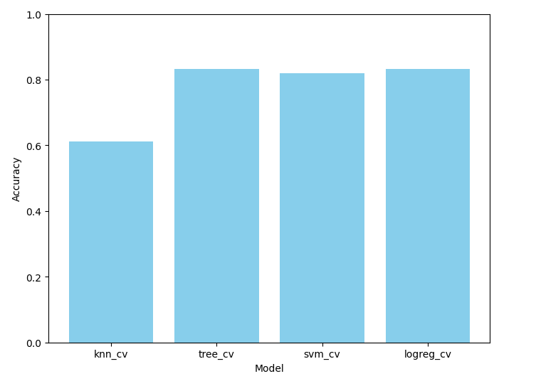
Classification Accuracy
The models "tree_cv" and "logreg_cv" exhibit the highest likelihood of success in the analysis, indicating their potential as strong candidates for further exploration and utilization in the given context.

Slide 43
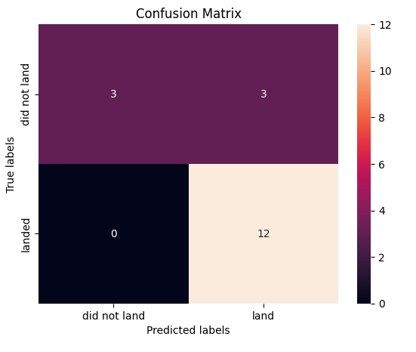
Confusion Matrix
Since two models performed equally on the test set, their confusion matrices were identical. They correctly predicted 12 successful landings and 3 unsuccessful ones. However, they also predicted 3 successful landings when they were actually unsuccessful (false positives), indicating a tendency to overpredict successful outcomes.

Slide 44
Conclusions
Our task was to develop a machine learning model for SpaceY, a potential competitor to SpaceX. The primary goal was to predict the successful landing of Stage 1 rockets, which could potentially save up to $100 million USD per launch.
I collected data from a public SpaceX API and scraped information from SpaceX's Wikipedia page. Subsequently, I labeled this data and stored it in a DB2 SQL database to facilitate further analysis.
I created a visualization dashboard to explore and understand the data more effectively. The machine learning model I built achieved an impressive accuracy rate of 83%, showcasing its potential usefulness.
This model could be a valuable asset for SpaceY, as it enables them to predict, with relatively high accuracy, whether a launch will result in a successful Stage 1 landing before proceeding. To further enhance the model's accuracy, I recommend collecting additional data, which could help determine the most effective machine learning model for this task.

Slide 45


